Slide 1


Commissioning

Slide 2

Steps in commissioning
Collect information
Check installation
Configure system
Setup site information

Slide 3
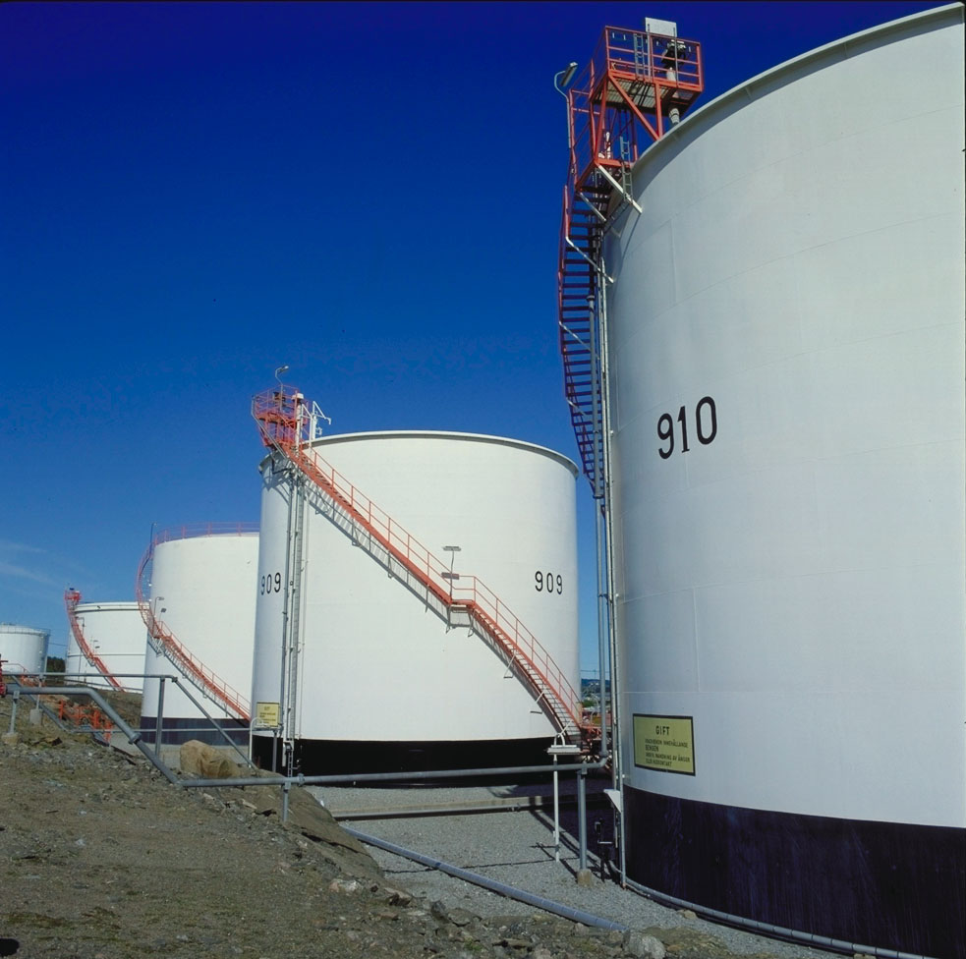
Steps in commissioning
Collect information
Tank distances
Like R-dist
Tank operation information
High and Low alarm levels
Tank capacity table
Product information
Type of product
Volume table used

Slide 4
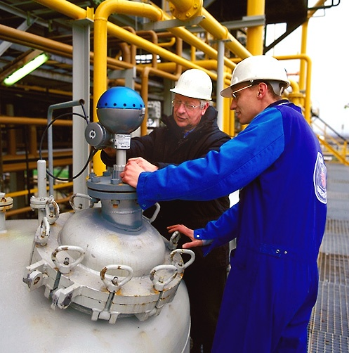
Steps in commissioning
Check installation
Mechanical installation
Electrical connections
Connections
Shield
Grounding
HOST
Computer
Network
DCS/SCADA connection

Slide 5
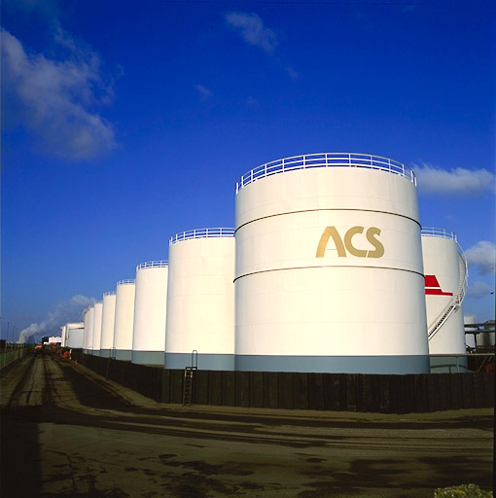
Steps in commissioning
Configure system
Power up field equipment
Install TankMaster
Configure the system
FCU’s
Gauges
Accessories
MST
WBS
I/O Terminals
and extras…

Slide 6

Steps in commissioning
Site specific information
Configure TankMaster
Tank Capacity Table
Product Information
High and Low alarm limits
HOST connection
Setup and check communication
Verify data transfer

Slide 7
Addressing field equipment
All equipment comes with a factory default address
Gauges will get an individual address during configuration
Unit ID is used for changing addresses on Field Bus
“Same address” can be reused on a second protocol (PC com port)
Default address | Rosemount rule for new
5900S Radar Gauge: | 1 - 50
5900S Radar Gauge 2-in-1 sec. unit | 51 - 100
2410 Tank hub: 247 | 101 - 200
22XX Aux Tank Devices: | N/A
5300/5400 Level Transmitters: | 1 - 50
FCU: 245 | 201 – 244
REX/PRO: 246 | 1 - 100
SDAU/IDAU: 247 | 101 - 200

Slide 8

Addressing field equipment
TK-21
LT-21
Add: 01
TK-22
LT-22
Add: 02
Numbering of:
FCU’s 201-244
Number of FB used
Number of gauge on each
RTG’s 1-100
Numbering (Tag)
Addressing
SDAUs, 2410 101-200
2410: number of devices connected
SDAUs: number of temp spots
TK-31
LT-31
Add: 03
TK-32
LT-32
Add: 04
TK-101
LT-101
Add: 11
TK-102
LT-102
Add: 12
FCU 1
Add: 201
FB 1
FB 2

Slide 9
Tank Geometry Configurations
Tank Reference Height (R)
Distance from Zero Ullage Reference Point to Zero Level Reference Point
Offset Distance (G)
Distance from 5900S/Rex/Pro reference point (the flange) to Zero Ullage Ref. Point. Offset Distance is negative if Zero Ullage Ref. Point is below Rex Ref. Point.
Bottom Offset Distance (C)
Distance from Zero Level Reference Point to tank bottom (always positive)

Slide 10
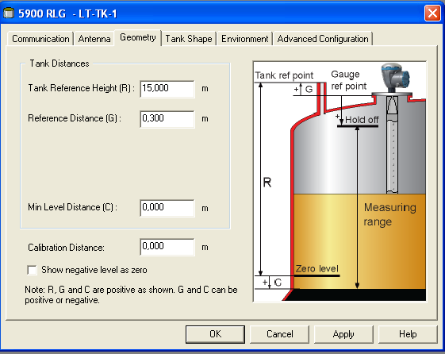
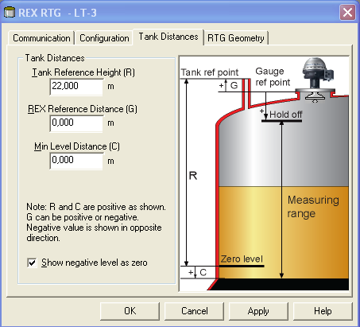
Tank Geometry Configuration
R + C should be equal to the actual distance from the Zero Ullage Reference Point to the real tank bottom
Geometry tab for 5900S
Tank Distance tab for Rex

Slide 11
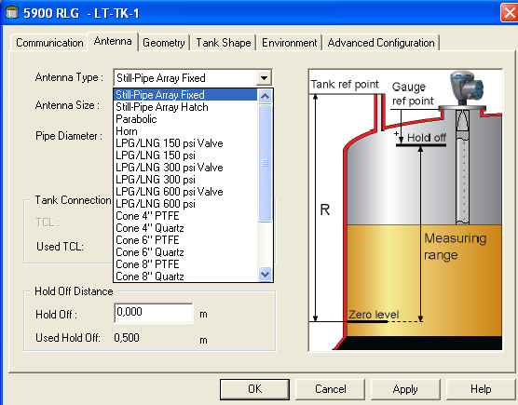
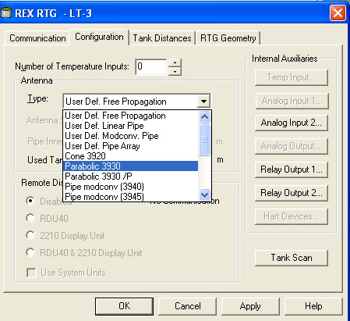
Antenna configuration
To simplify configuration a number of predefined antenna types can be configured
When using predefined antennas, TCL and Hold Off distance are automatically set-up

Slide 12
Antenna configuration
If a predefined antenna is not available, 3 different “User Defined Antenna” types can be selected.
Free Propagation (i.e. REX 3920)
Mode Conversion Pipe (i.e. REX 3940)
Linear Pipe (i.e. REX 3960)
‘User Defined’ Antennas needs manual entry for: - TCL - Hold Off Distance.
When Pipe Antenna is selected and Pipe Diameter > 0, the level value will be compensated for the lower microwave propagation speed in pipes.
Very important with an exact Pipe Inner Diameter.

Slide 13
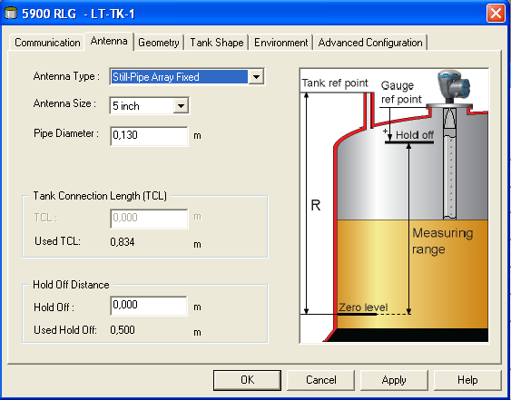
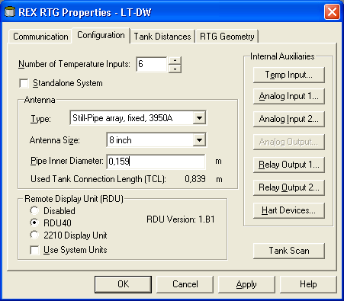
Antenna configuration

Slide 14
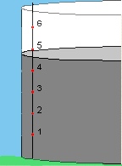
Average temperature
Knowing the level and spot height the system can calculate the acutal average temperature of the product
Spot 6: 17,5°C
Spot 5: 18,1°C
Spot 4: 27,3°C
Spot 3: 27,5°C
Spot 2: 28,3°C
Spot 1: 28,2°C
Avg temp: 27,8°C

Slide 15
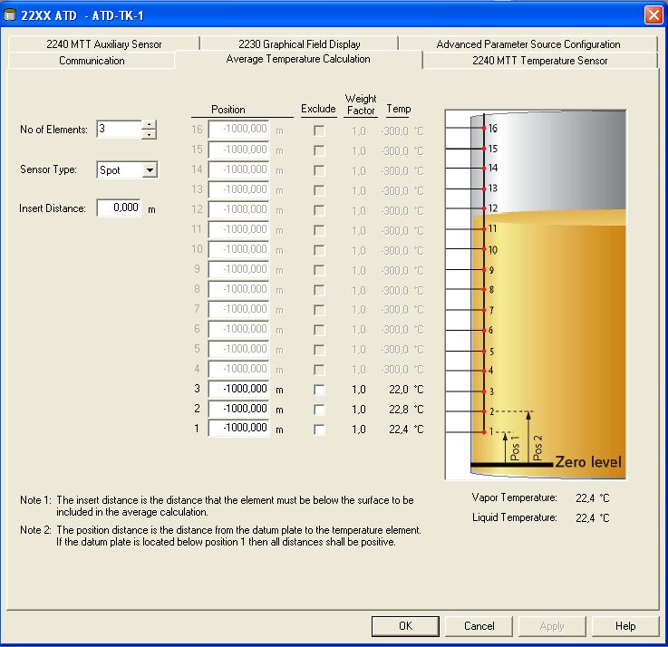
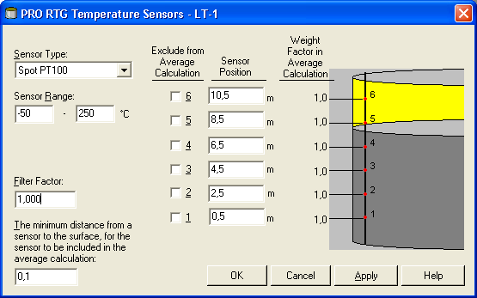
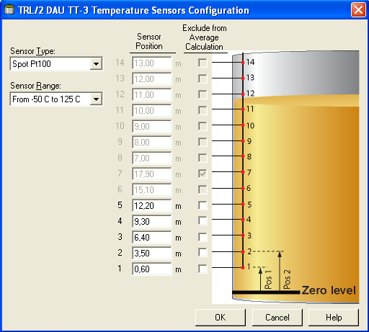
Temperature sensors
Notes:
Spot heights are marked on label placed at MST top

Slide 16
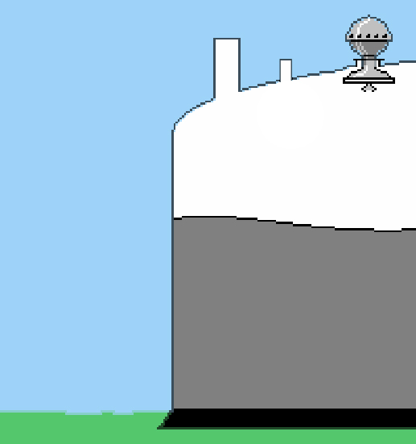
Reference difference T-Dist
Reference difference
T-Dist

Slide 17
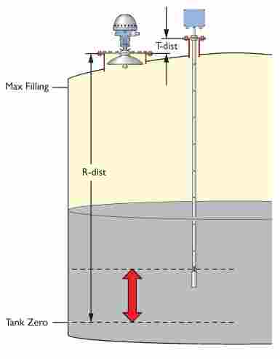
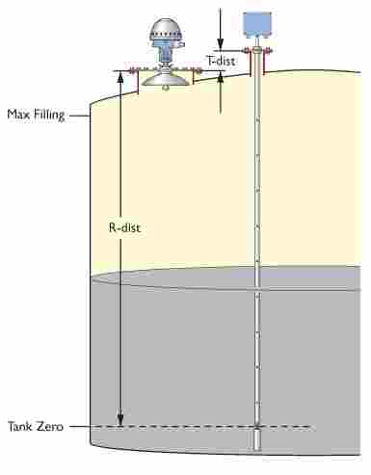
MST installation

Slide 18
Temperature sensors
API Chapter 7 – Section 4
4.3.2.1 ”The upper element about 1m from product surface...”
4.3.2.2 ”MST elements are installed at approx. 3m intervals...”
6 spots gives a maximum tank reference height of approx. 20m
1 m to max fill level
3 m
3 m
3 m
3 m
3 m
1 m

Slide 19
Temperature sensors
Configuration of Temperature sensors.
Sensor number 1 must have the lowest tank position etc.
All sensors must be of the same type (average or spot).
All sensors must have the same transfer function from Ω to °C.
Handling.
Each sensor value is updated every other second.
Possibility to have an off-set distance for avg. calculation.
Broken/faulty sensor can be excluded from average temp calculation.

Slide 20
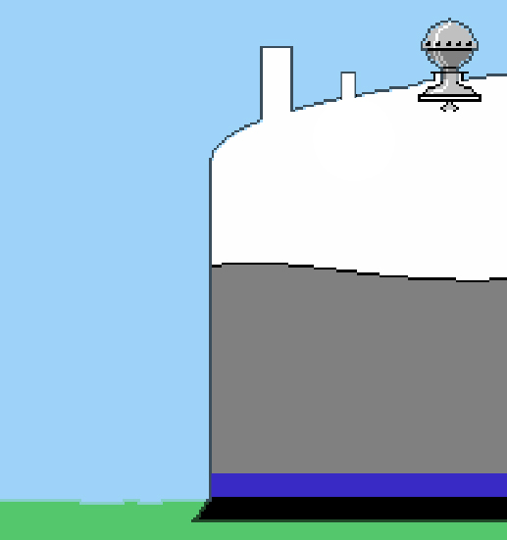
Water Level Sensor
Keep control over water in tank.
Sum of product inventory depends on presence of water
Zero point of WLS compared to Tank Zero Point (Datum Plate) important for the performance
Error here will affect all inventory calculation.

Slide 21
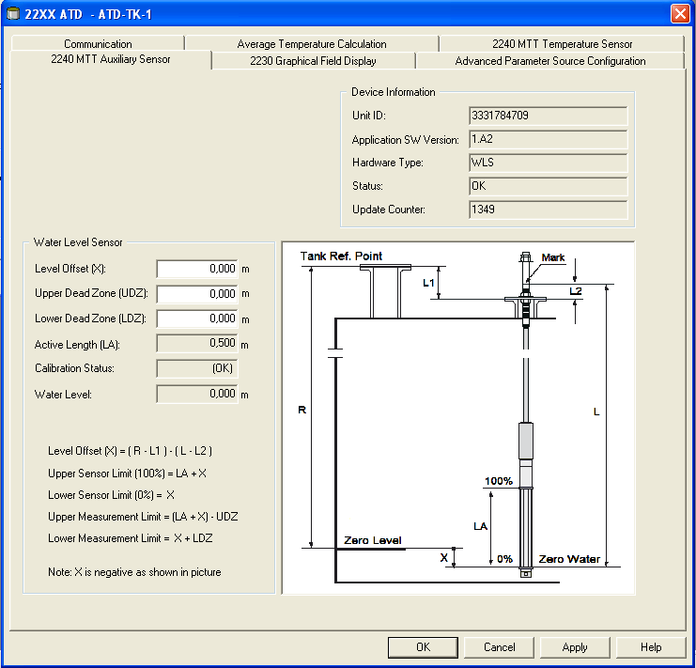
WLS Configuration in Raptor
2240S Auxiliary Sensor tab

Slide 22
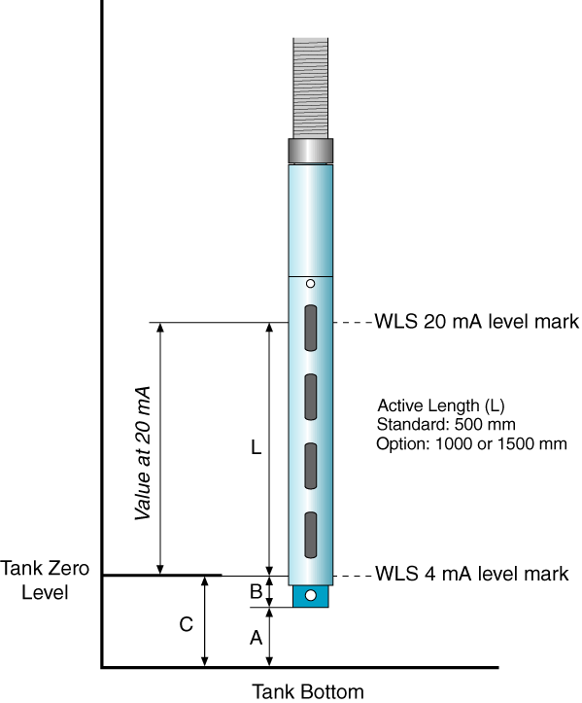
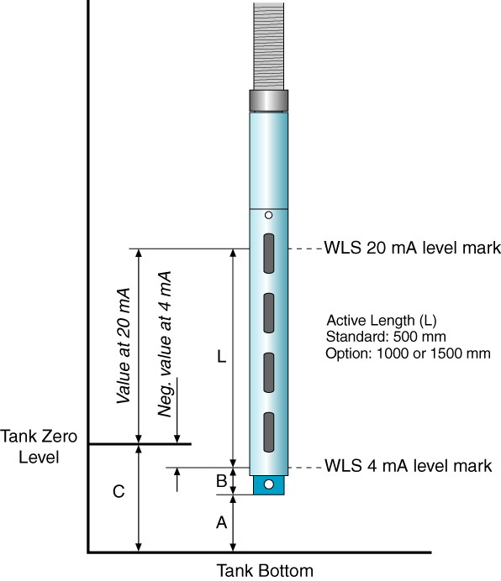
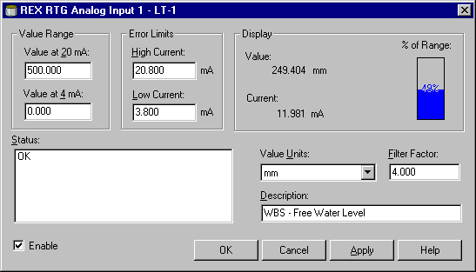

WLS Configuration in Rex

Slide 23

Tank details
HIHI
HI
LO
LOLO
Max Volume
Tank
Capacity
Table
Alarm Limits
Min volume and
Sump Volume

Slide 24
Level alarms
TankMaster alarms
On screen alarm, PC speaker
Relay output via I/O Terminal, External Horn/Light
Field alarms
Local horn/light at tank side
Valve control
Raptor
2 relays (option) + 1 SIL-relay (SIL 3 certified) in 2410 Tank hub
REX relay
2 relays(option), SIL-2 approved, TÜV overfill approval
PRO relay
External relay box, TÜV overfill approval

Slide 25
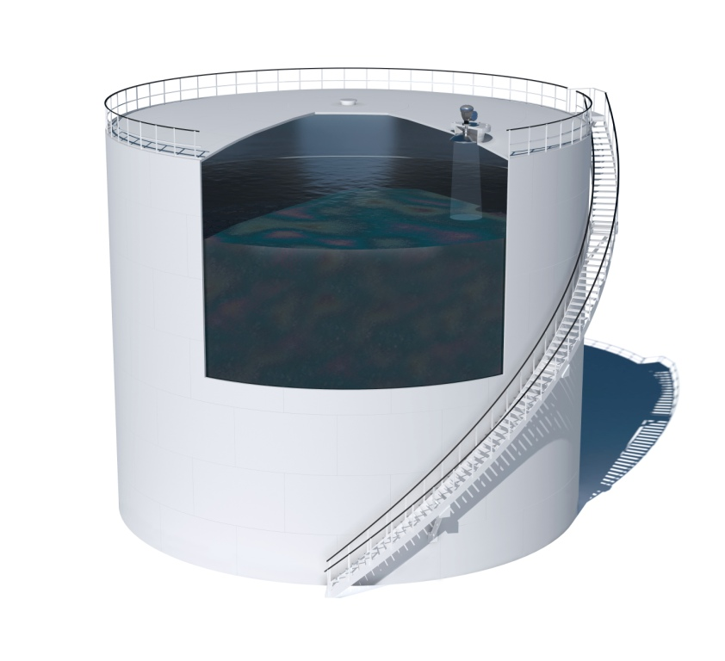
Tank Capacity Table
Calibration table for the tank
Information about
Tank heights
Volume per level point
Verify that the table is available for the time of commissioning
”Copy & Paste from MS Excel into TankMaster
Up to 5000 points
Type of tables:
Raw
Straight Level-Volume
International
Northern
Includes volume factors for each segment

Slide 26
Calibration and verification
Free propagation antenna:
Calibration 1 point
Verification 1 point after moving level
Pipe antenna:
Calibration 1 point
Verification 4 points at different levels (20, 40, 60, 80%)
If needed: final calibration
Verification 1 point after moving level

Slide 27
Not to forget…
…after commissioning
Back up TankMaster
Save the TM data base in safe place
Your office, not customer site
We (RTR) might want to see it if you face problem
Back up Field device
Save Holding registers
Save Input registers
View and save Tank Spectra
A complete backup might be a good help in the future…

Slide 28
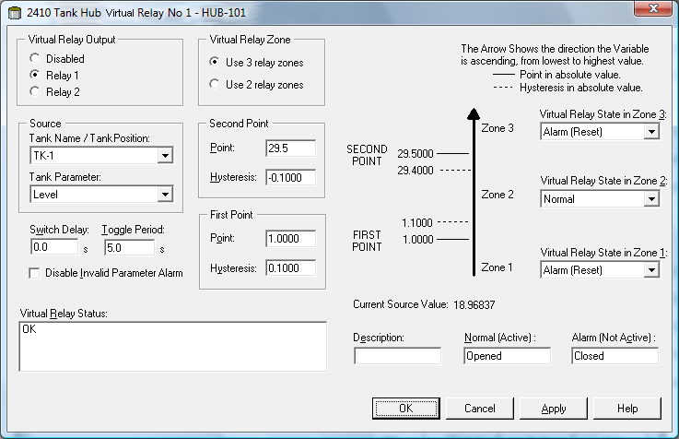
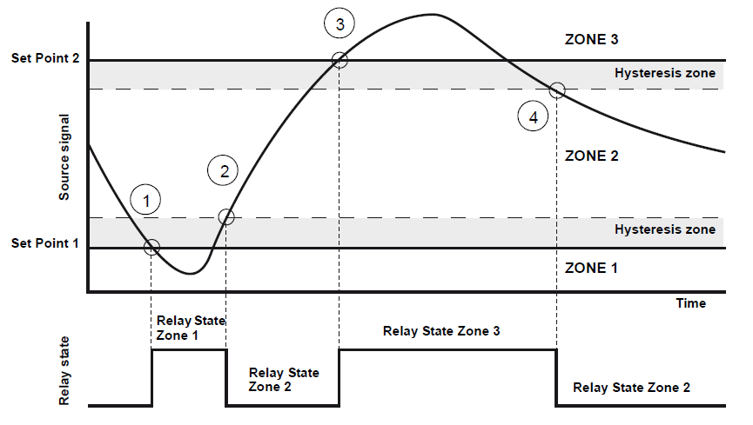
Relay setup Raptor
Configuration Tab in 2410 Tank hub Properties
Two or three relay zones
Two: use First Point
Three: Use First & Second Point
Notes:
The first and second set points define the transitions between Zone 1, 2 and
3. You can set different relay states in each of these zones.
First Point defines the transition between Zone 1 and 2.
Second Point defines the transition between Zone 2 and 3.

Slide 29
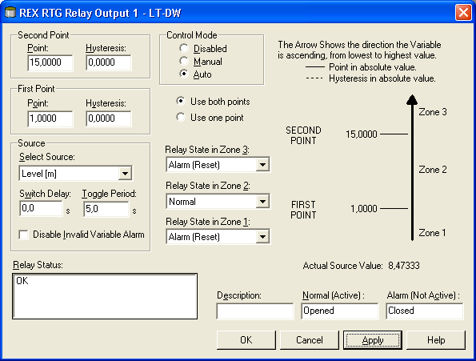
Relay setup Rex

Slide 30
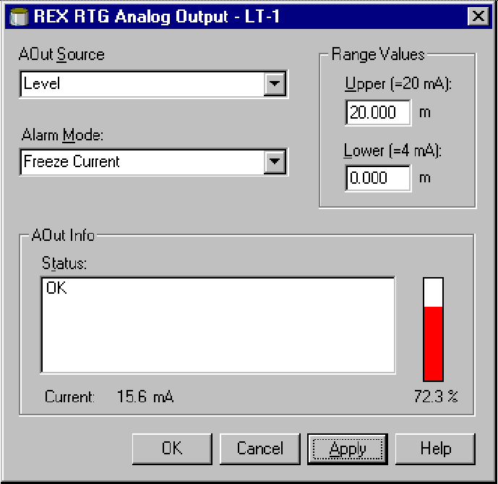
Analog output Rex
Key features:
One precision current loop output (16-bit).
Update rate every 0.5 sec.
Extended range of parameters level, ullage, temp etc.
Status indication freeze, low or high.
Configurable low (default 3.8 mA) and high (default 22.0 mA) alarm status.
Notes:
No Ain/Aout in Raptor today; future options according to technical description

Slide 31

Additional information
What product will be filled into the tank?
Volume table to be used?
54A, B or C…?
Hybrid setup
Pressure transmitters
Online density measurement
Floating roof
Roof weight
Included in TCT?

